Slide 1

The E-Learning Platform
“Making the Transition to Remote Learning Easier”
Team : Lone_Developers
Prototype: https://learn-live.herokuapp.com/

Slide 2
Why This Theme ?
More Relatable
Know the in’s and out’s
Provide the “right” platform

Slide 3


1. Teachers
Easy to Use
Modular Contents
Highly Flexible
Provide Assignments, Slides, etc.
Announcements

Slide 4
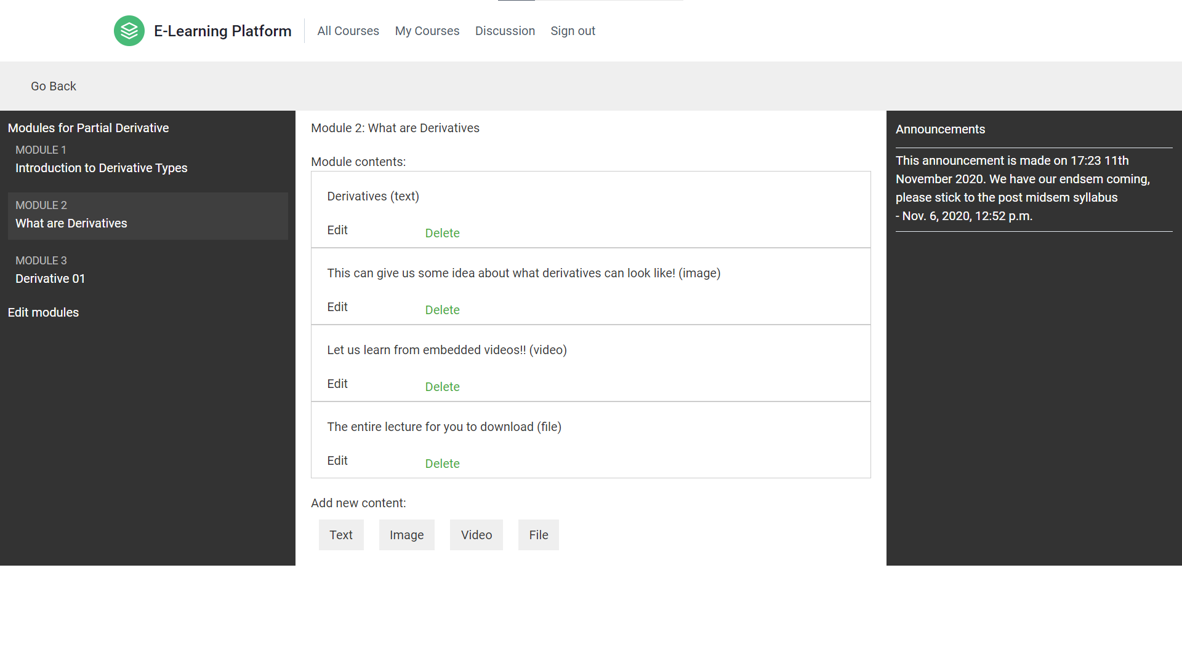
Tip
In this example, we’re leading off with something unexpected.
While the audience is trying to come up with a number, we’ll surprise them with the next slide.

Slide 5
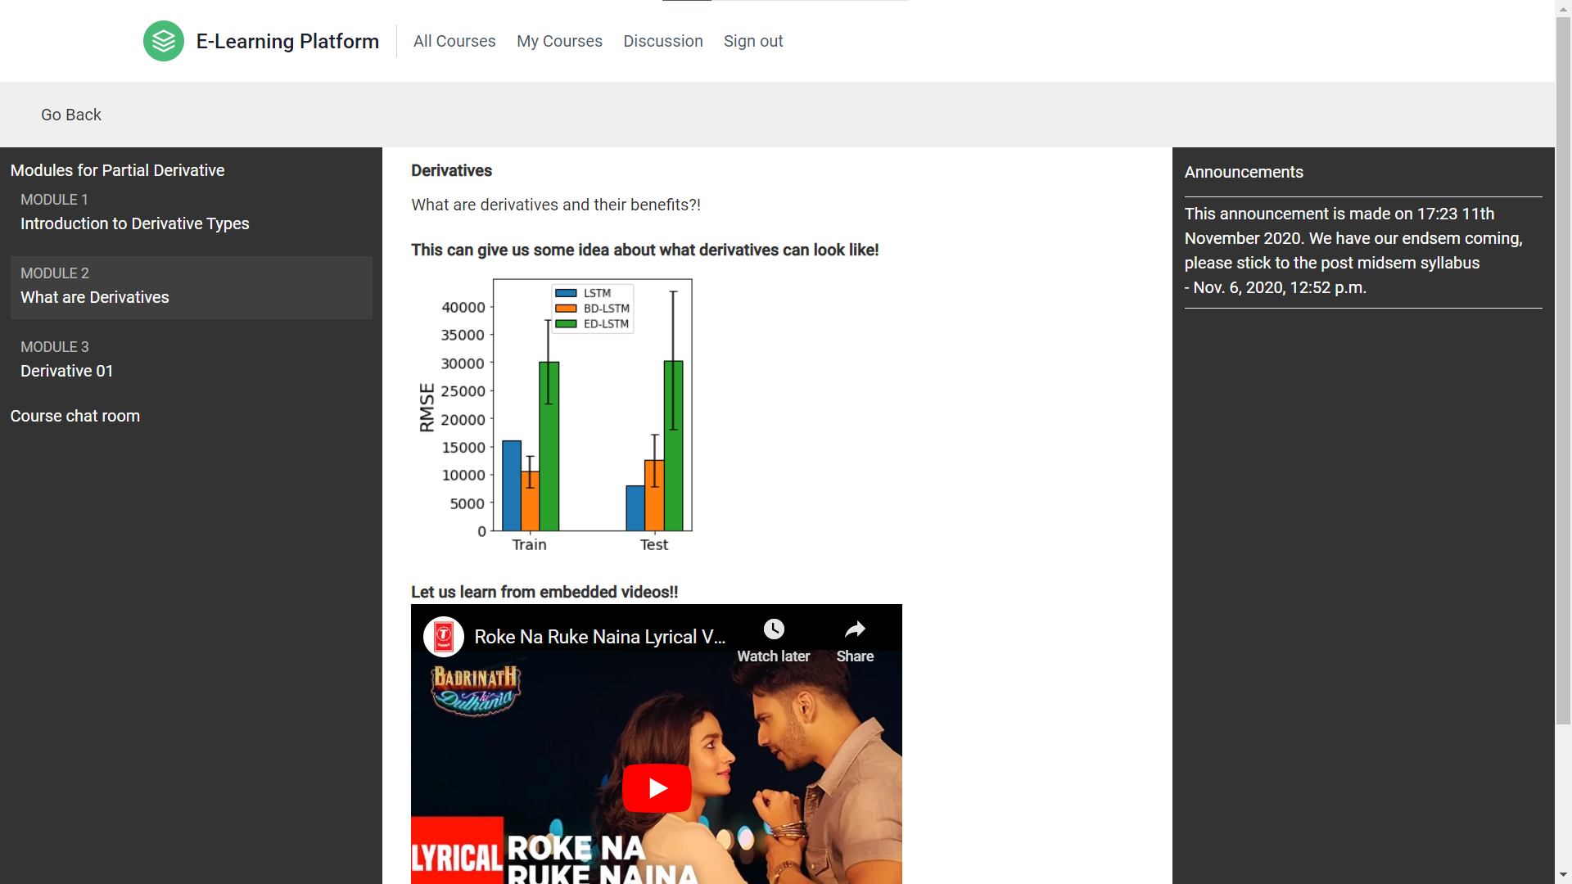
Just one! Your own.
(With a little help from your smart phone)
Tip
Remember. If something sounds like common sense, people will ignore it.
Highlight what is unexpected about your topic.

Slide 6

‘It takes a Big Heart to help shape little minds’

Slide 7
2. Students
Easy to Use
Modular Contents
Course Specific Chat Rooms
Easy Enrollments
Announcements

Slide 8
3. Parents
Easy to Use
Upcoming Holidays, Events
Each Child’s Progress Report
Track Announcements of their children

Slide 9
THE DISCUSSION PLATFORM
A community, where anyone can upload any content
A place for sharing useful resources directly with everyone
Teachers, Students and Parents can participate in this community

Slide 10
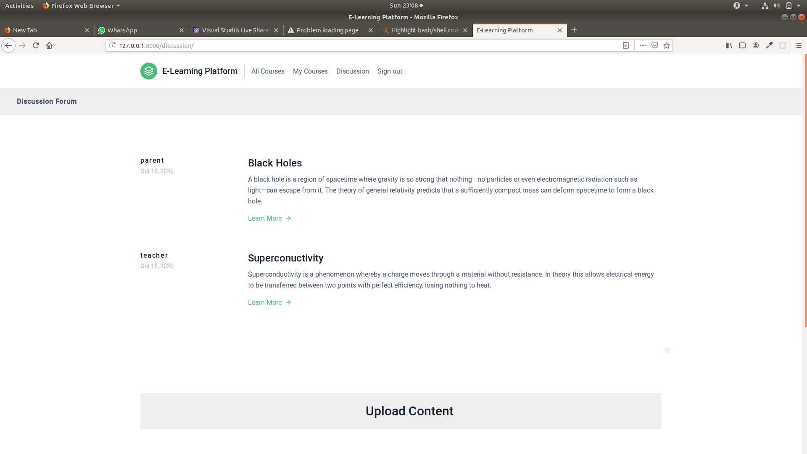
Just one! Your own.
(With a little help from your smart phone)
Tip
Remember. If something sounds like common sense, people will ignore it.
Highlight what is unexpected about your topic.

Slide 11


More than 50% of student course content gets cached!!
This provide the users (students) the best RESPONSE TIME AND USER EXPERIENCE COMBINED
Tech
We used Python memcached and it’s django library support django-memcache-status

Slide 12
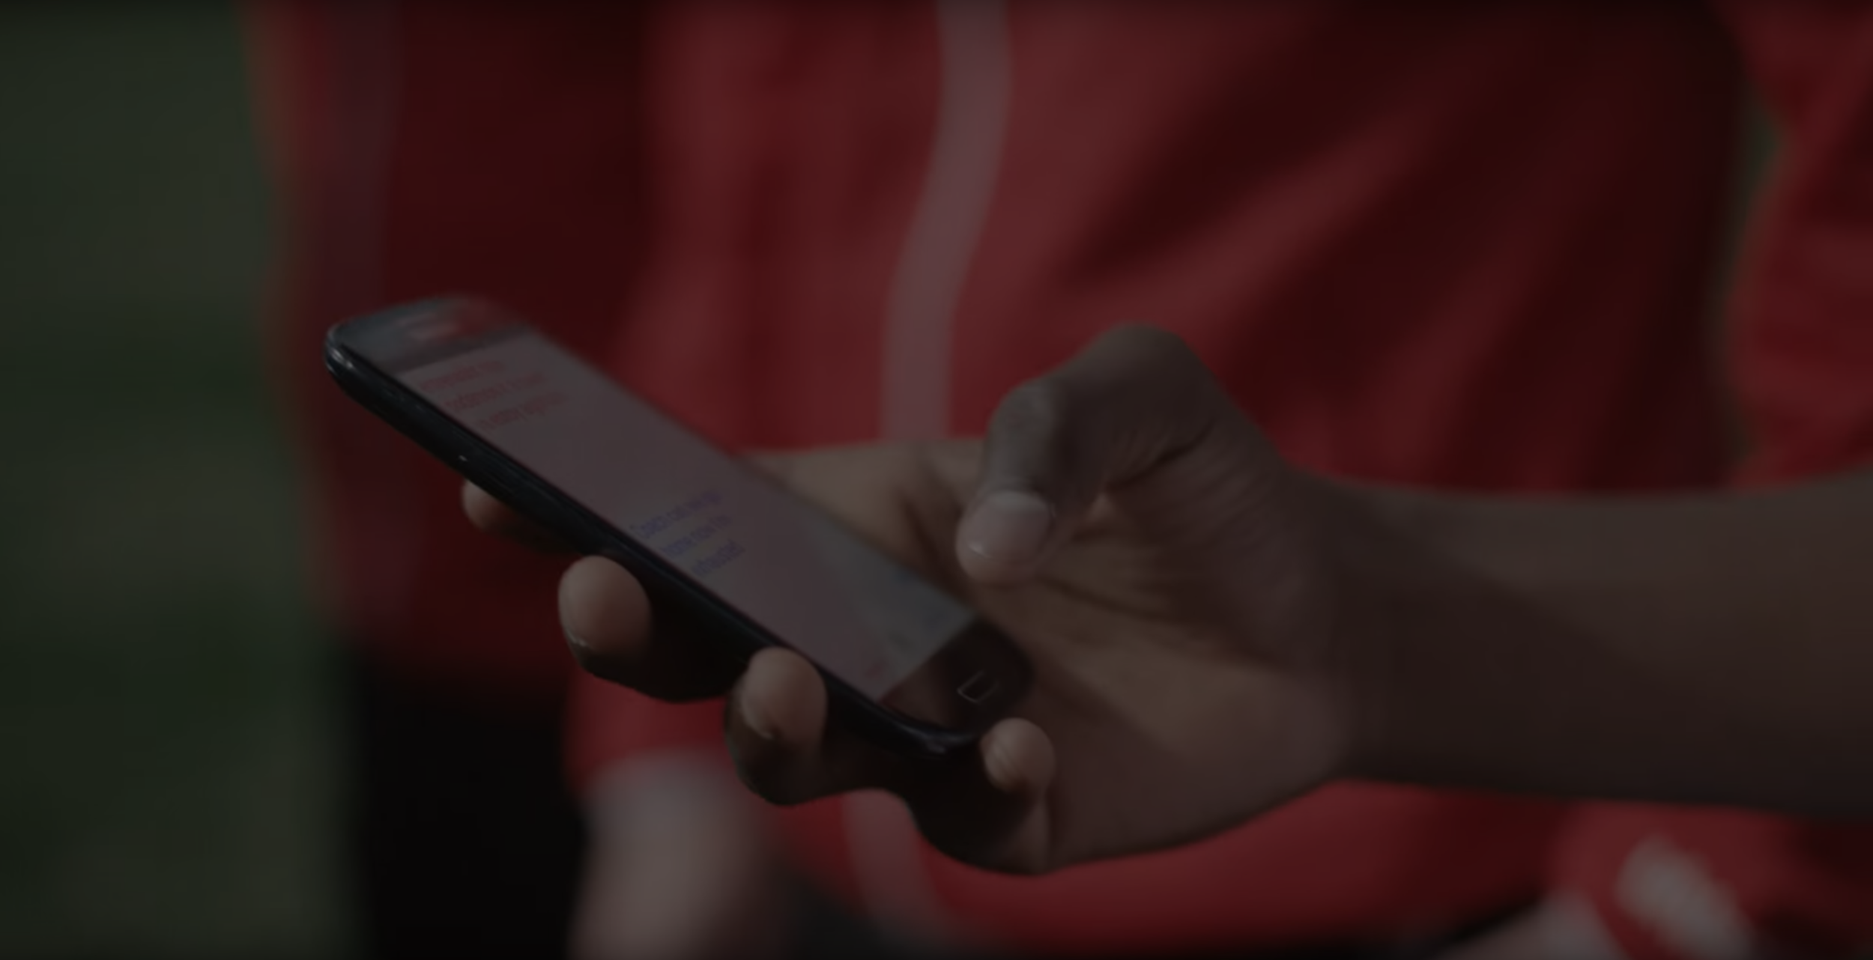
Anyone Can Embed Our Course Content On Their Website
What!
Yes. we are providing API integration of our courses, so that can be used for Promotion and Marketing by anyone whom we permit.

Slide 13
Meet Our Future!
We aim to integrate following features before we bring this to market.
User Specific Course Progress
Live Classes Support
Course Feedback Options
Live Quizzes on our platform

Slide 14
The Team
Team Name : Lone_Developers
Ayush Jain
Kunal Solanke
Dushyant
Leader
Back End Developer
Front End Developer
The only thing that unites us is our keen interest in Using Tech as a Tool to solve real life problems.
We are passionate developers, who are always looking for opportunities to Learn, Grow and Contribute!

Slide 15
Thank You!
We hope you liked the way we developed our product and look forward to listen from you!
To test our product, please visit https://learn-live.herokuapp.com/
We would appreciate any feedback from your side and are more than happy to answer your queries!

